Slide 1
Linear Algebra
Lecture 20

Slide 2
Vector Spaces

Slide 3
Vector Spaces
and Subspaces

Slide 4
Definition
Let V be an arbitrary nonempty set of objects on which two operations are defined, addition and multiplication by scalars.

Slide 5
If the following axioms are satisfied by all objects u, v, w in V and all scalars l and m, then we call V a vector space.

Slide 6
Axioms of Vector Space
For any set of vectors u, v, w in V and scalars l, m, n:
1. u + v is in V
2. u + v = v + u

Slide 7
3. u + (v + w) = (u + v) + w
4. There exist a zero vector 0 such that
0 + u = u + 0 = u
5. There exist a vector –u in V such that
-u + u = 0 = u + (-u)

Slide 8
6. (l u) is in V
7. l (u + v)= l u + l v
8. m (n u) = (m n) u = n (m u)
9. (l +m) u= I u+ m u
10. 1u = u where 1 is the multiplicative identity

Slide 9
Example 1
The set of all ordered n-tuple R^{n} is a vector space under the standard operations of addition and scalar multiplication.

Slide 10
Note
Three cases of R^{n} are
R (the real numbers)
R² (the vectors in the plane)
R³ (the vectors in 3-space)

Slide 11
Example 2
The set V of all 2x2 matrices having real entries with normal matrix addition and scalar multiplication

Slide 12
Example 3
Let V be the set of all real-valued functions defined on the entire real line.
If f, g in V, and a in R, then
(f +g) (x) = f (x) + g (x),
(a f ) (x) = a f (x),

Slide 13
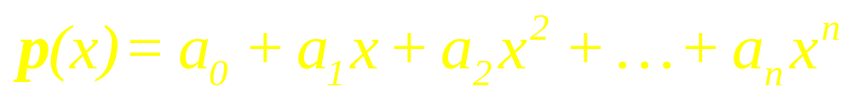
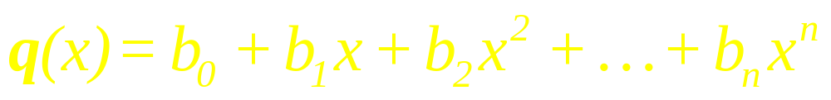
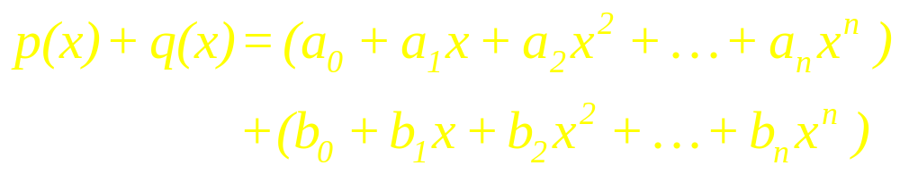
Example 4

Slide 14
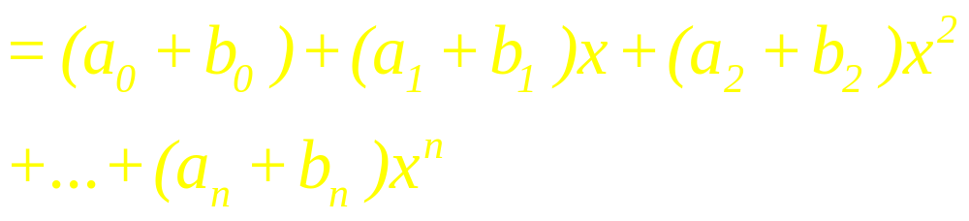
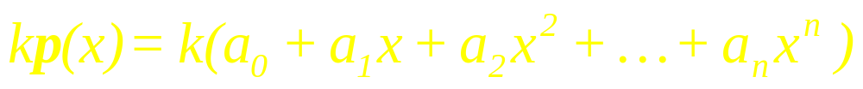
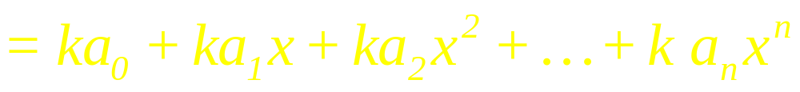
Continued

Slide 15
Example 5
Let V consist of a single object {0} and 0 + 0 = 0 and k 0 = 0 for all scalars k.
zero vector space.

Slide 16
Example 6
Let V be any plane through the origin in R³. The set of points in V is a vector space under normal addition and scalar multiplication

Slide 17
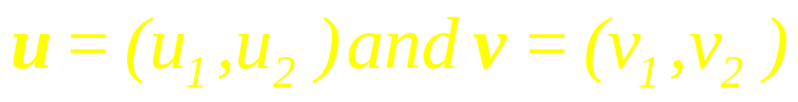
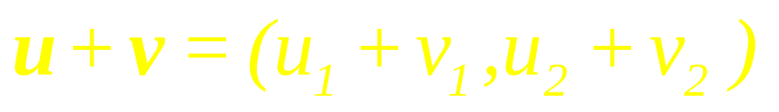
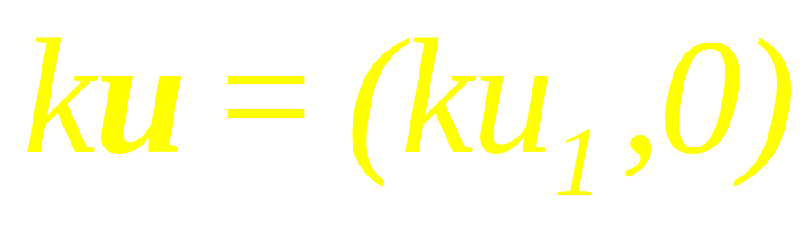
Example 7

Slide 18

Solution
For any vector u in V,
1u = 1(u₁, u₂) = (1 u₁, 0)
= (u₁, 0) u
Axiom 10 is not satisfied.

Slide 19
Definition
A subset W of a vector space V is called a subspace of V if W itself is a vector space under the addition and scalar multiplication defined on V.

Slide 20
Theorem
If W is a set of one or more vectors from a vector space V, then W is subspace of V if and only if the following conditions hold:

Slide 21
Continued
(a) If u and v are vectors in W, then u + v is in W
(b) If k is any scalar and u is any vector in W, then k u is in W.

Slide 22
Note
Every vector space has at least two subspaces, itself and the subspace {0}

Slide 23
Example 8
Let W be the subset of R³ having vectors of the form (a, b, 0), where a and b are real numbers.
Is W a subspace of R³?

Slide 24
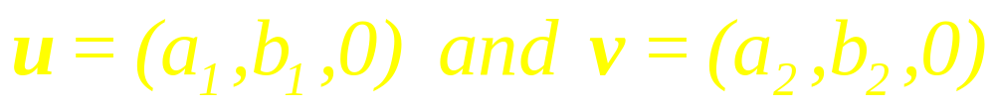
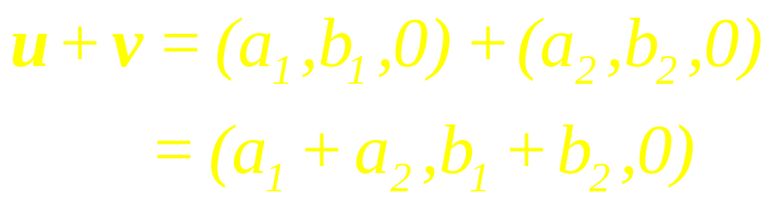

Solution

Slide 25
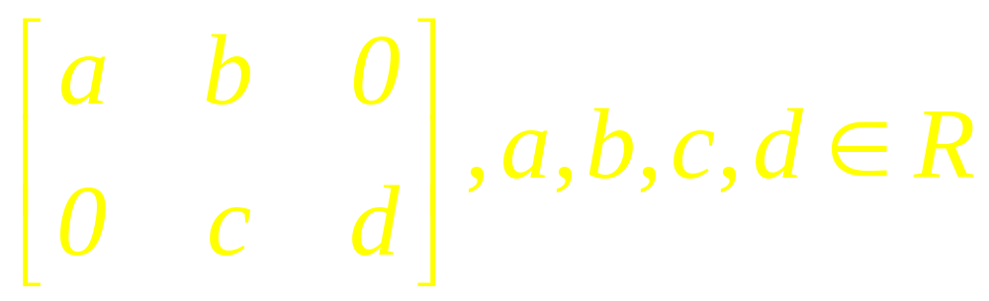
Example 9
The set W consisting of all 2x3 matrices of the form is a Subspace

Slide 26
Example 10
W, a subset of R^{3,} having vectors of the form (a, b, 1), where a, b are any real numbers is not a subspace of R³.

Slide 27
Theorem
If Ax = 0 is a homogeneous linear system of m equations in n unknowns, then the set of solution vectors is a subspace of R^{n}.

Slide 28
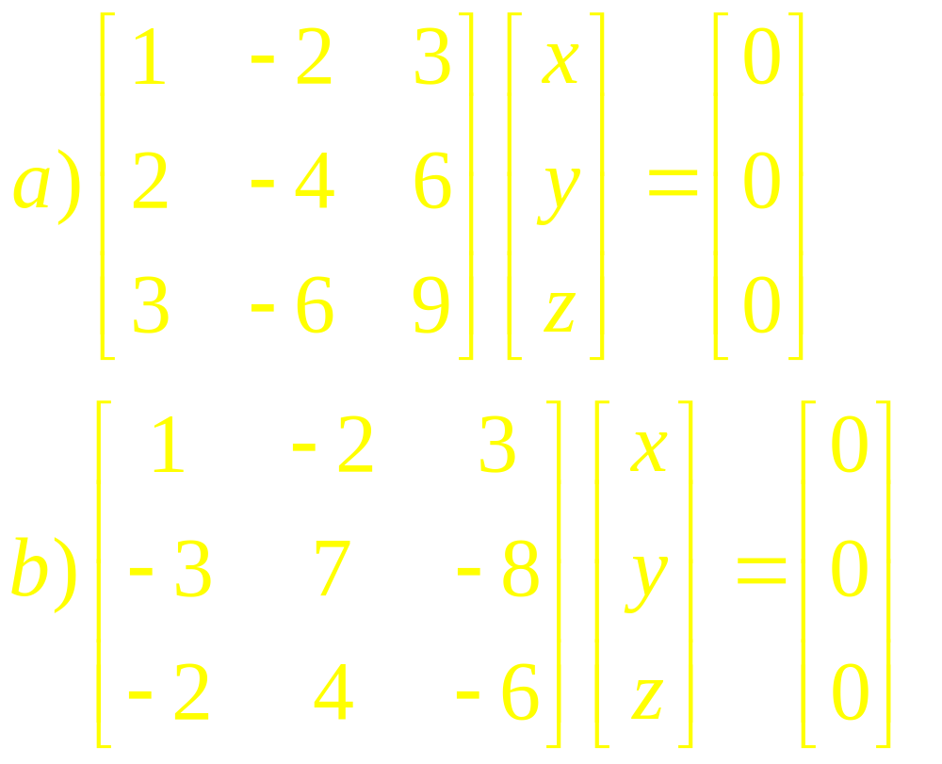
Example 16

Slide 29
Example 17
If v₁ and v₂ are in V,
then H = Span {v₁, v₂}
is a subspace of V.

Slide 30
Theorem
If v₁, … , v_{p} are in V, then Span { v₁,…, v_{p} }
is a subspace of V.

Slide 31
Example 18
The Set
H = {(a – 3b, b – a, a, b): a and b in R}.
is a subspace of R⁴.

Slide 32
Linear Algebra
Lecture 20

